Slide 1

GROUP 3
Anti-Money Laundering Detection with Graph Neural Networks (GNN)
1/18

Slide 2
01 | Introduction
02 | Survey
03 | Data
04 | Methods
05 | Implementation
06 | Results
07 | Conclusion
TABLE OF CONTENTS
2/18

Slide 3
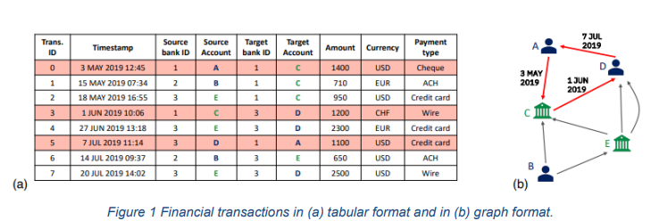
Example
I. Introduction
Sophisticated financial crime: Money laundering is a complex and widespread financial crime.
Global threat: It poses a significant threat to the global financial system.
Concealment of illegal origins: Involves processes to hide the origins of money obtained through illegal activities.
Examples of illegal activities: Such activities include drug trafficking, terrorism, fraud, and corruption.
3/18

Slide 4

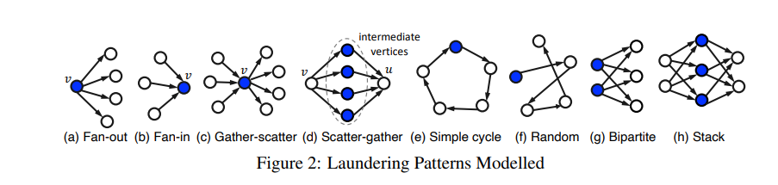
All laundering in the data follows one of these 8 patterns. As with other aspects of this data noted above, knowing all the transcation involved in particular laundering patterns is an immense challenge with real data.
4/18

Slide 5
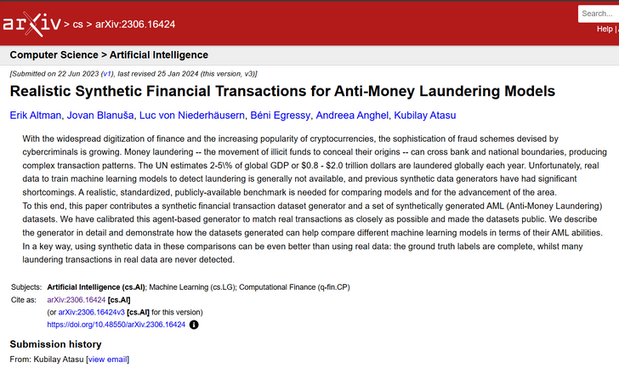
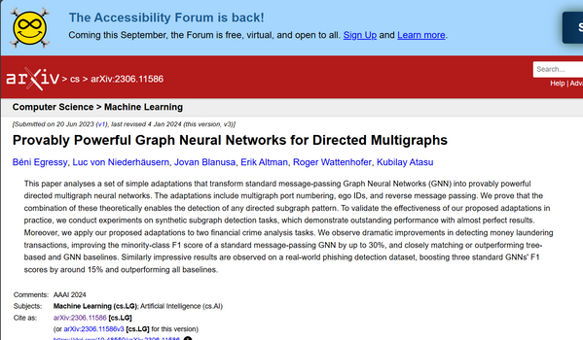
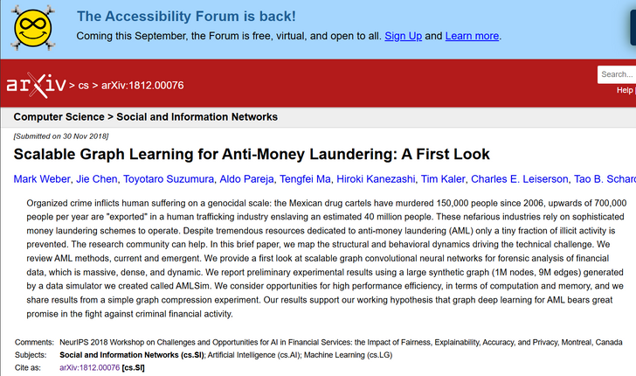
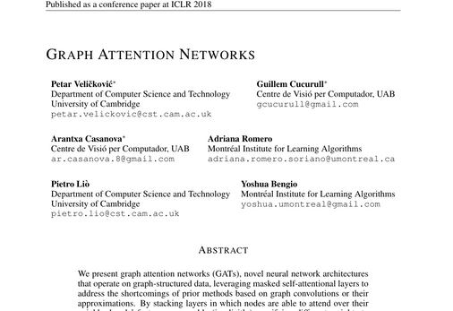

II.Survey
This survey examines key studies that have contributed to the understanding and development of GNNs in the context of AML detection:
Realistic Synthetic Financial Transactions for Anti-Money Laundering Models: discusses synthetic financial datasets that enhance AML model training without privacy concerns, allowing for better exploration of complex laundering patterns.
Provably Powerful Graph Neural Networks for Directed Multigraphs: explores GNNs for directed multigraphs, showcasing their effectiveness in modeling complex financial relationships and detecting hidden illicit activities.
Scalable Graph Learning for Anti-Money Laundering: focuses on the scalability of Graph Convolutional Networks (GCNs), showing how they reduce computational burdens while effectively modeling financial networks.
Graph Attention Networks: how attention mechanisms improve detection accuracy by focusing on key parts of the network.
5/18

Slide 6

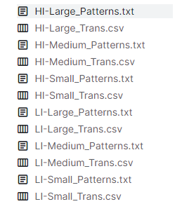

III. DATA
6 datasets here divided into two groups:
Group HI (Higher Illicit Ratio)
Group LI (Lower Illicit Ratio)
Two files for each of the six datasets:
.csv: Transactions
.txt: Laundering Pattern Transactions
6/18

Slide 7

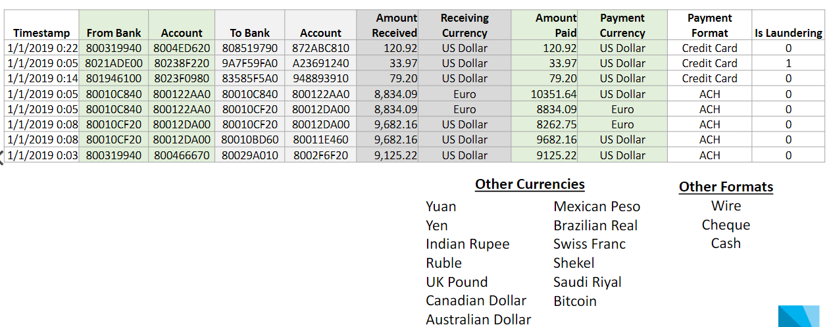

AML – SAMPLE TRANSACTION
7/18

Slide 8


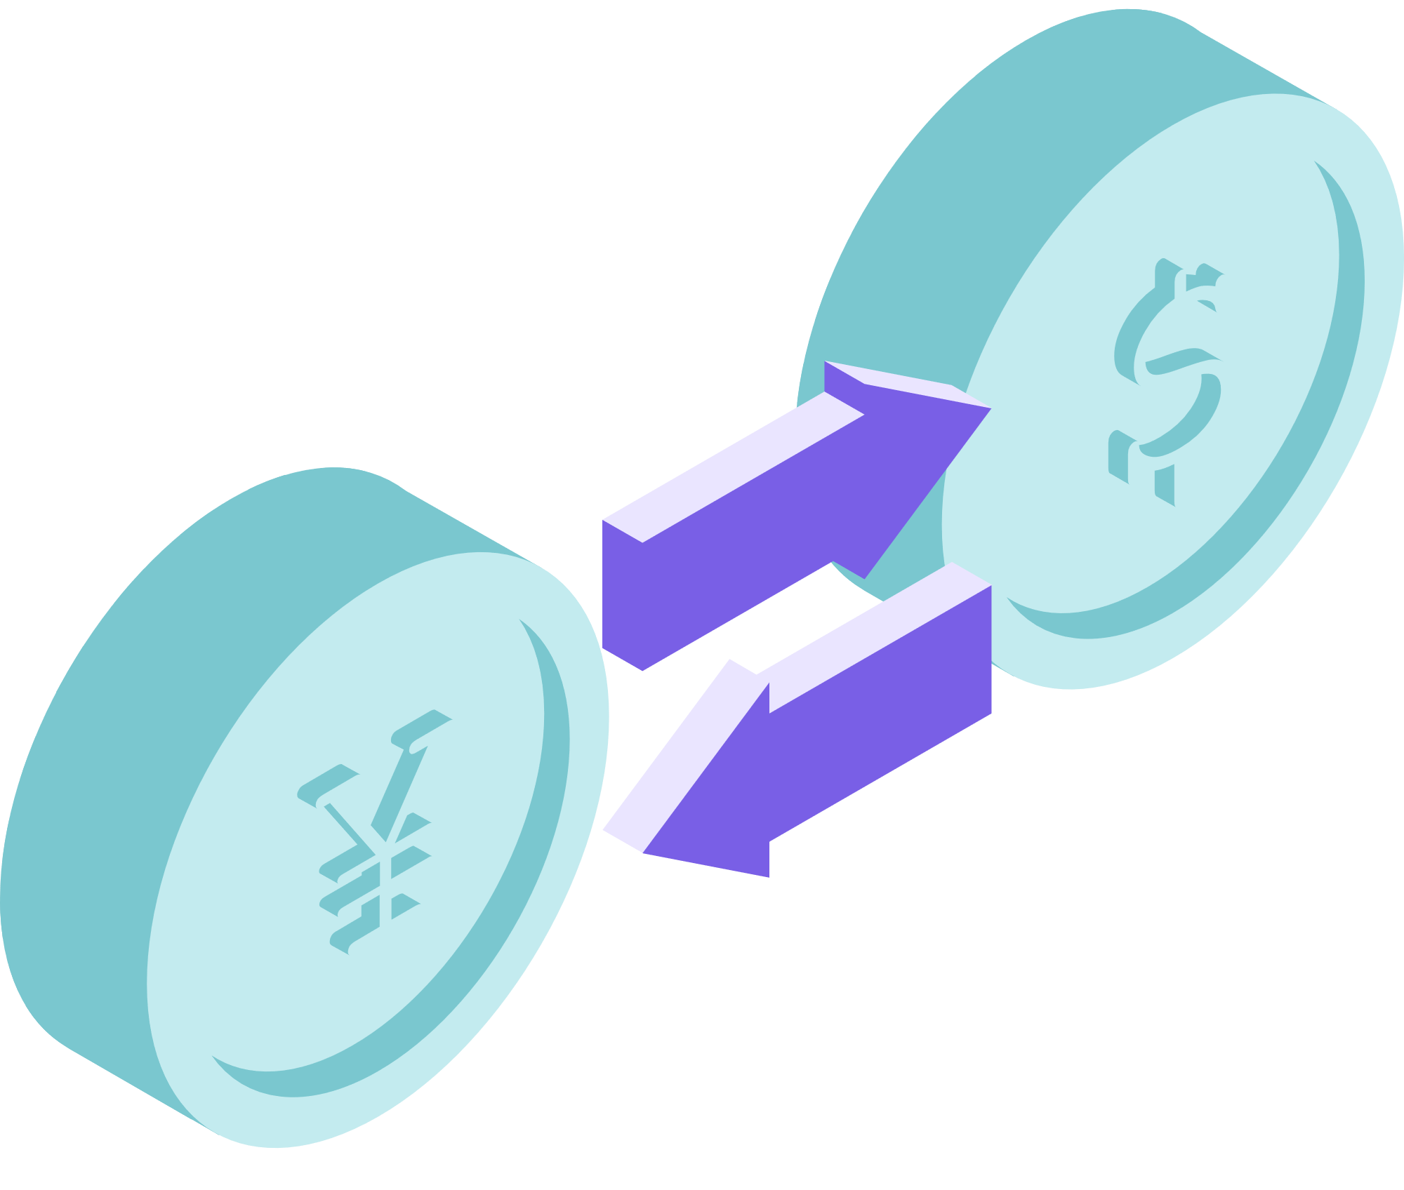
Methods
8/18

Slide 9
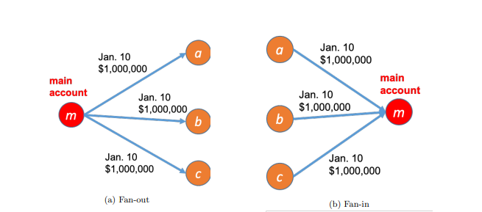
1. Why Apply Graph Neural Networks (GNNs)?
Typical Patterns in Financial Networks:
Fan-Out Patterns: This occurs when a single account disperses funds across multiple other accounts.
Fan-In Patterns: This pattern is observed when multiple accounts funnel funds into a single account.
Circular Patterns: funds are cycled between accounts, often through multiple layers of transactions
Graph Neural Networks (GNNs) provide a powerful alternative to traditional methods by leveraging the structure of financial transaction networks.
Connectivity of Financial Transactions:
Nodes: nodes represent entities such as bank accounts, individuals, or companies.
Edges: Edges represent the financial transactions between these entities.
9/18

Slide 10
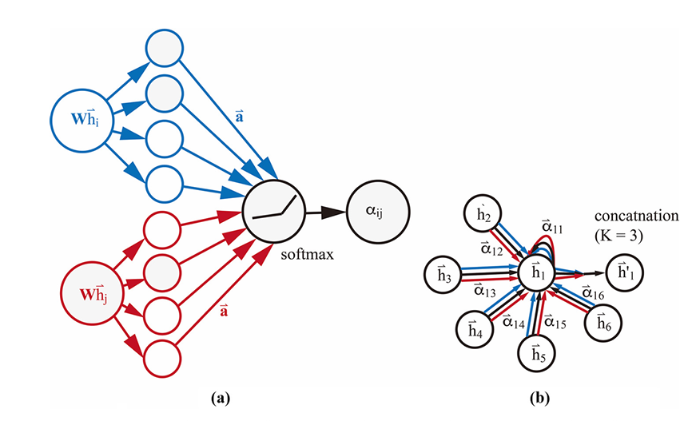
2. Overview of Graph Attention Networks (GAT)
01 | Attention Mechanism: Dynamically weighs the importance of each edge, crucial for assessing the risk in financial transactions.
02 | Information Aggregation: Gathers information from the most relevant edges to update node features, reflecting both the node’s attributes and its key neighbors.
03 | Multi-Head Attention: Uses multiple attention heads in parallel to enhance model robustness, capturing diverse perspectives and richer features.
04 | Non-Linear Transformation: Applies a non-linear function (e.g., ReLU) to aggregated features, allowing the model to capture complex relationships within the graph.
10/18

Slide 11
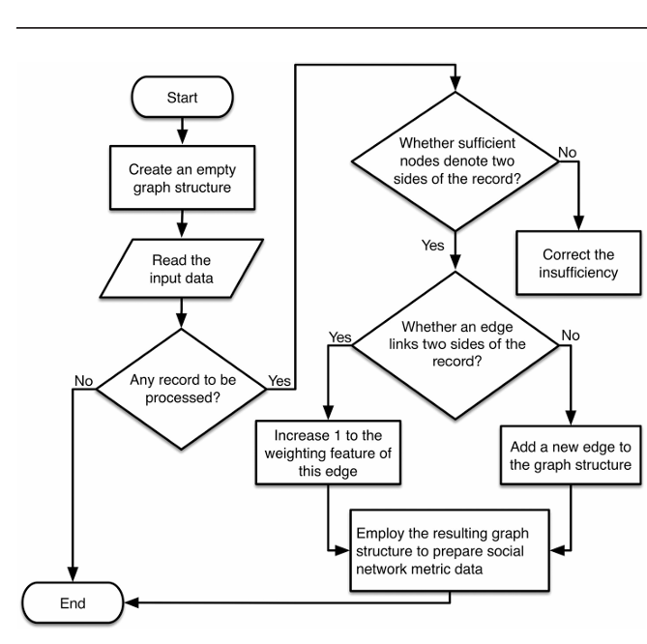
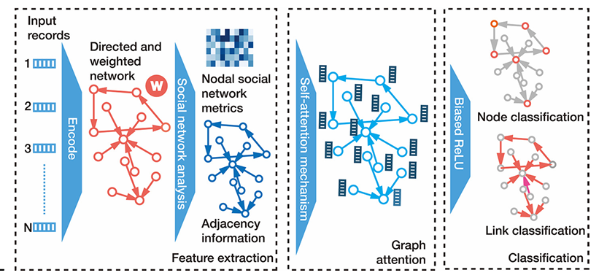
3. Application of GAT to the AML
11/18

Slide 12
GRAPH CONVOLUTIONAL NETWORKS (GCN):
Architecture: Aggregates neighbor information through convolution, applying a linear transformation and non-linear activation.
Limitations: Treats all neighbors equally, which may overlook crucial patterns in detecting money laundering.
4. Comparison with GCN and GIN
GRAPH ISOMORPHISM NETWORKS (GIN):
Architecture: GINs use summation for neighbor aggregation, followed by an MLP, enabling them to capture subtle differences in graph structures.
Strengths: Highly expressive in distinguishing structural properties of graphs, though this can increase computational complexity, especially in large-scale graphs.
COMPARATIVE ANALYSIS:
Performance:
GAT: Excels in weighting important transactions, ideal for detecting AML.
GCN: Faster and more scalable but may miss key patterns.
GIN: Strong in distinguishing complex structures, but computationally intensive.
Scalability:
GCN: Best for large graphs due to faster training.
GAT: Captures subtle patterns but may require more resources.
GIN: Powerful but resource-heavy, especially with complex graphs.
12/18

Slide 13

5.Evaluation Metric:
F1 Score: Essential for imbalanced data, balancing precision (correctly flagged illicit transactions) and recall (accurately detecting illicit transactions). A high F1 score indicates effective detection with minimal false positives.
13/18

Slide 14
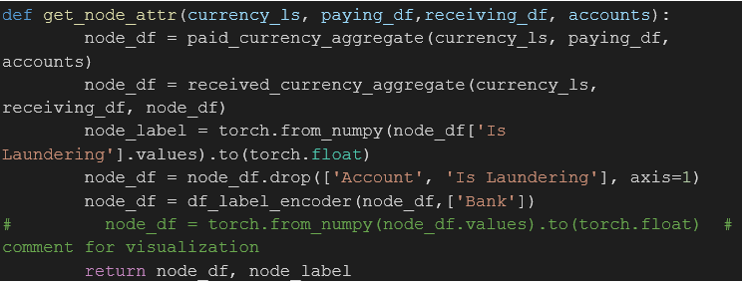
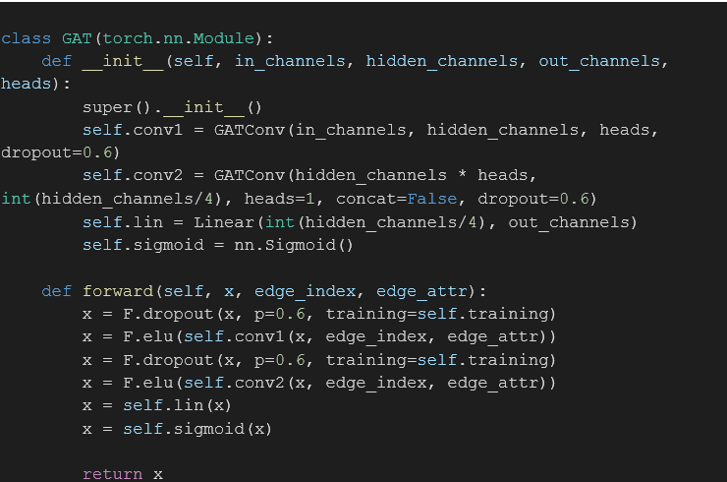
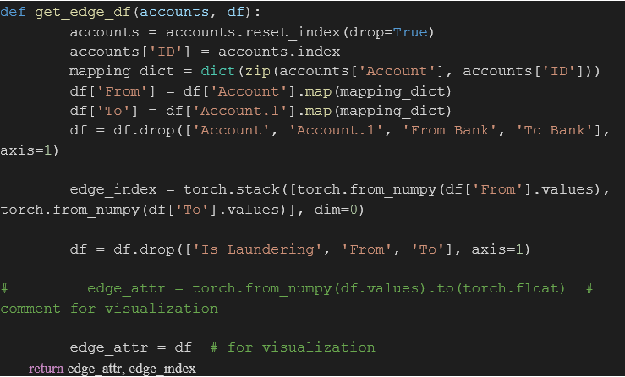
14/18
Implementation
2. Graph Construction
+ Node features
Data Loading and Preprocessing
+ Label Encoding
+ Timestamp Normalization
+ Unique Identifiers
3. GAT Model Architecture
+ Input Layer
+ GAT Layers
+ Output Layer
+ Edge features

Slide 15
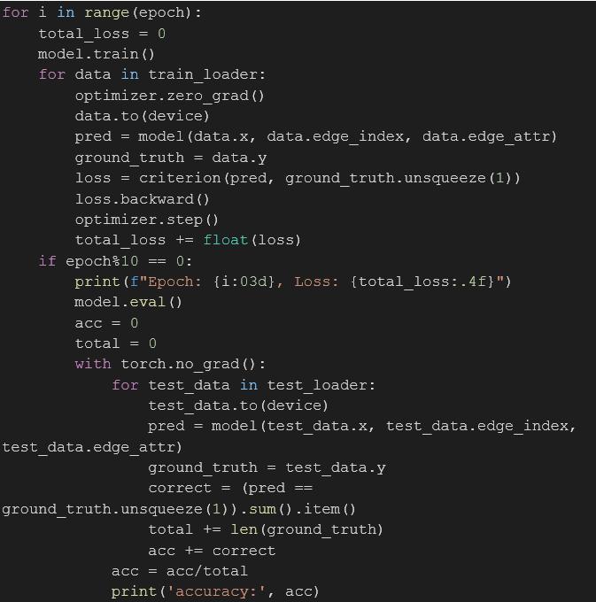
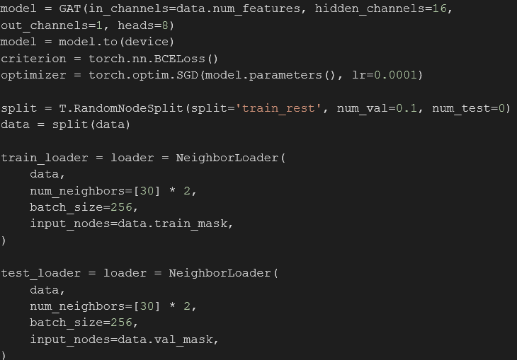
5. Model Evaluation
Implementation
4. Training the Model
+ Attention Mechanism
+ Optimization
15/18

Slide 16



2. Graph Attention Network (GAT)
VII. Results
Graph Convolutional Network (GCN)
3. Graph Isomorphism Network (GIN)
16/18

Slide 17
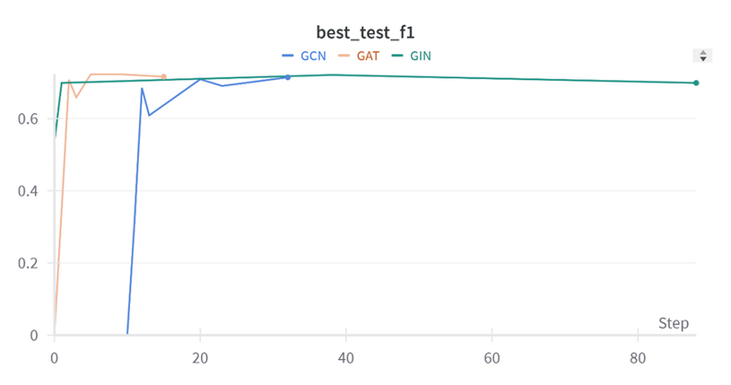
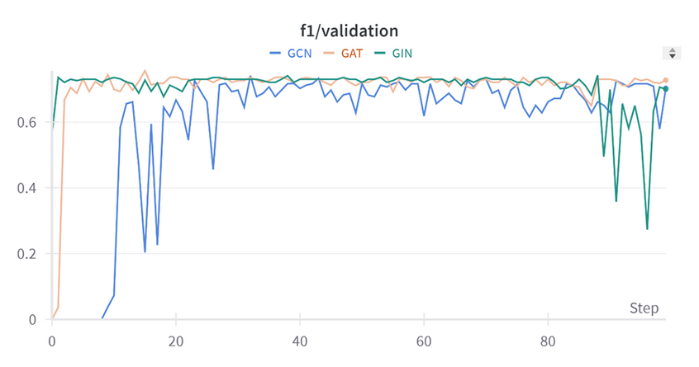
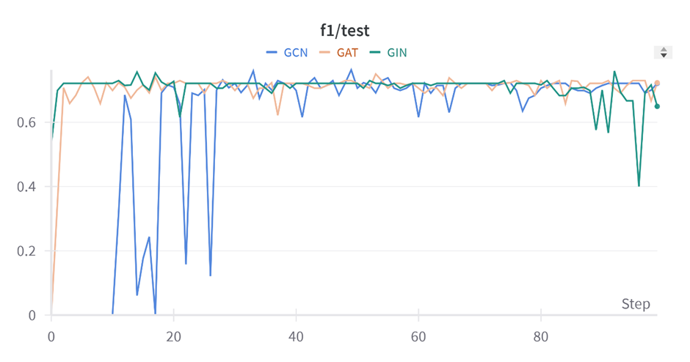
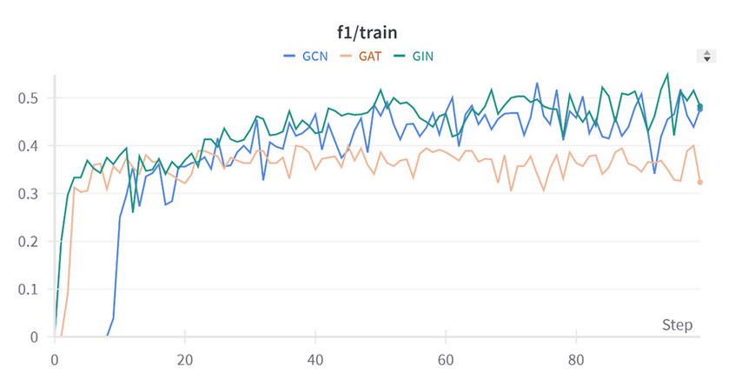
4. Comparative Analysis
17/18

Slide 18



Conclusion
Potential of GNNs: The study shows that GNNs can enhance Anti-Money Laundering (AML) systems beyond traditional methods.
Successful Application: GNNs help reduce false positives and improve regulatory compliance in financial institutions.
Future Research: Focus on improving GNNs for real-time financial environments and integrating them with other techniques.
Comparison of GNN Architectures: GAT outperforms GCN and GIN in money laundering detection due to its ability to identify complex patterns.
Synthetic Data from IBM: Using synthetic data is a safe and effective way to develop GNN models.
Contribution to the Field: The study makes a significant contribution to applying machine learning in finance and enhancing AML.
18/18

Slide 19
THANK YOU !

